Slide 1
https://codeburst.io/algorithms-i-searching-and-sorting-algorithms-56497dbaef20

Slide 2
CSS143 Computer Programming (II)

Slide 3
Homework 1 Review

Slide 4
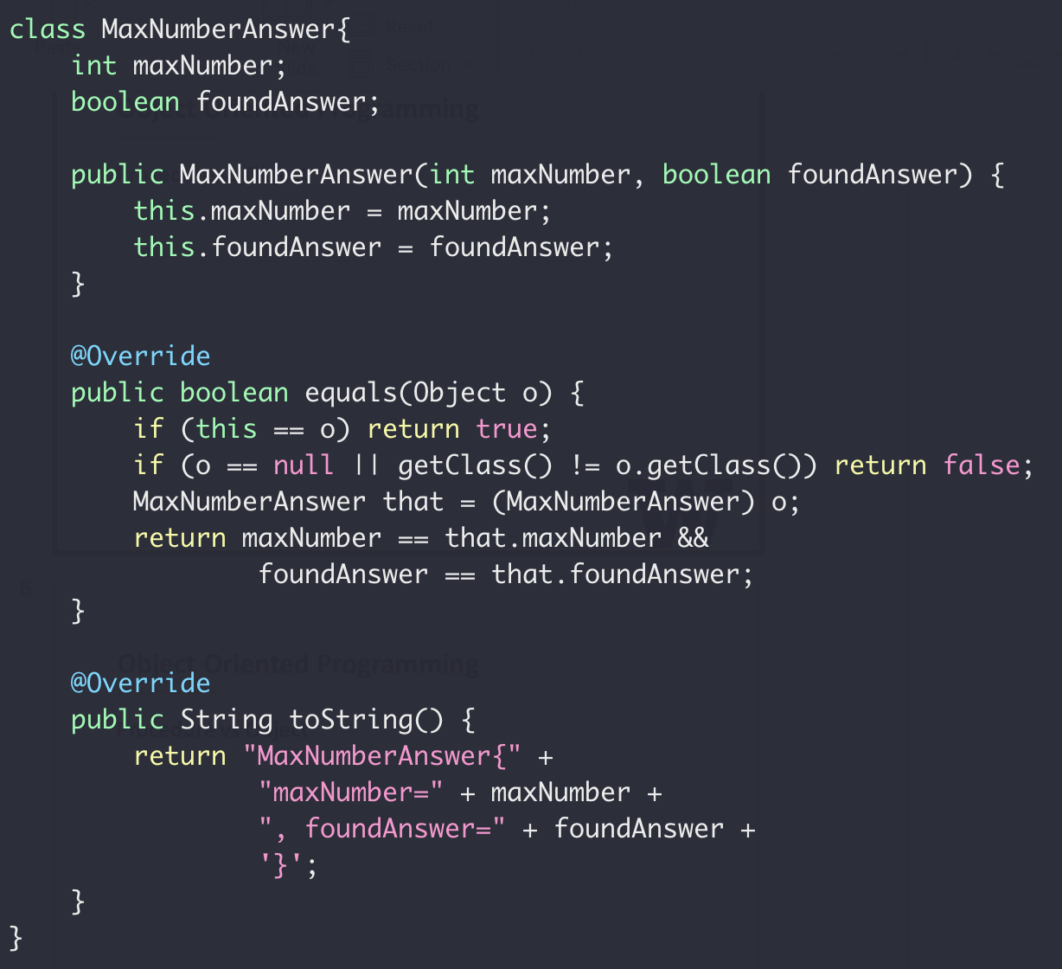
Object Oriented Programming
Find the maximum number in an array
Return value:
Max value
IsValid

Slide 5
Object Oriented Programming
Class
Variables
Variables
Methods
Methods
A class is a type like
int, float, boolean

Slide 6
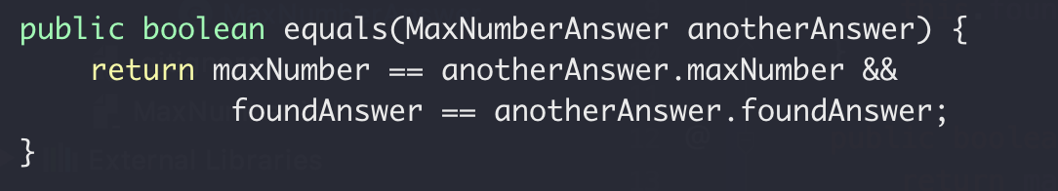
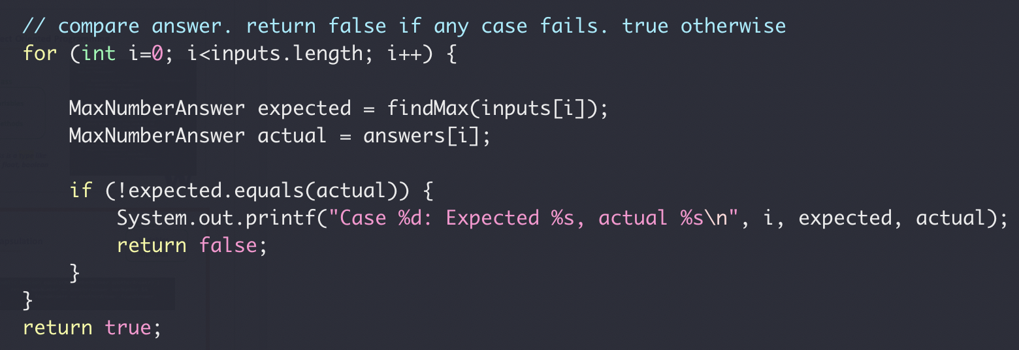
Encapsulation
Class
Variables
Methods
MaxNumberAnswer.equals(…)
testFindMax()

Slide 7
Class Exercise
Implement a class for cats
Member Variables:
Name
Gender
Age
Member Methods:
Speak
Play

Slide 8
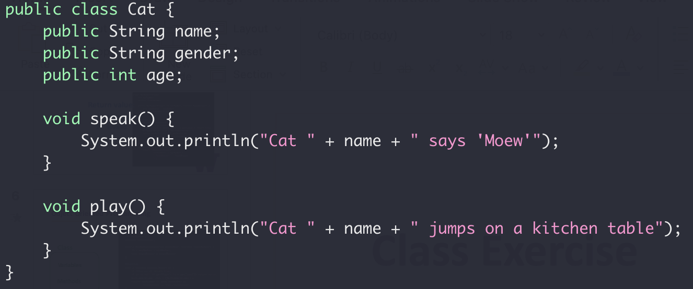
Class Exercise
Implement a class for cats

Slide 9
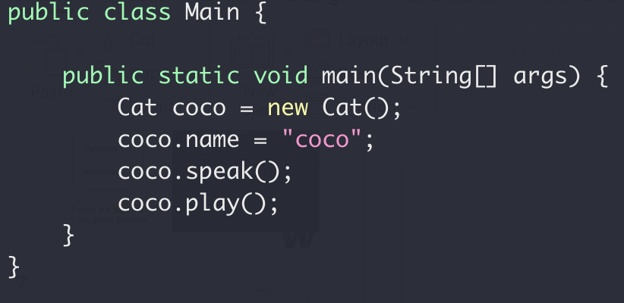
Class Exercise
Implement a class for cats

Slide 10
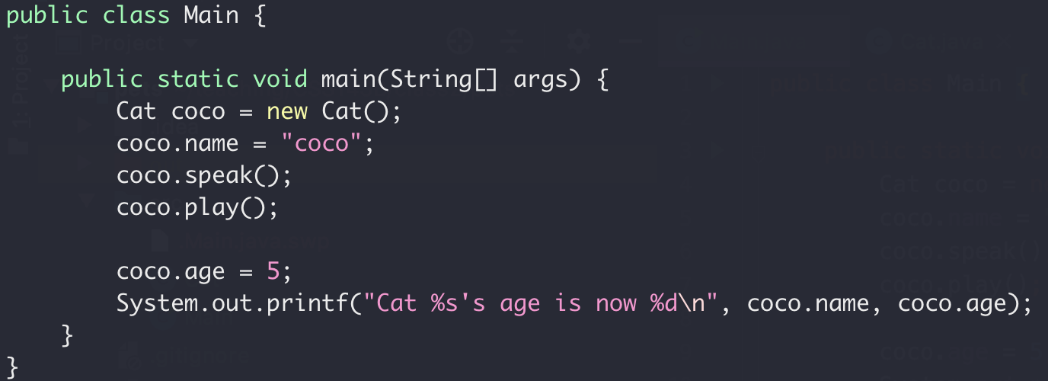
Encapsulation
Nop!
Your age is 5.
Me
☹

Slide 11
Encapsulation
Class
Variables
Variables
Access
public Methods
Methods
Setter/Getter
Read/Write
private Methods

Slide 12
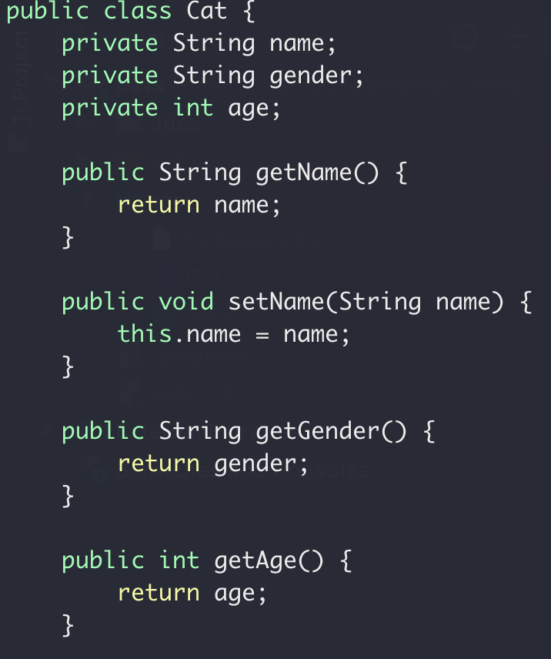
Class Exercise
Setter and Getter

Slide 13
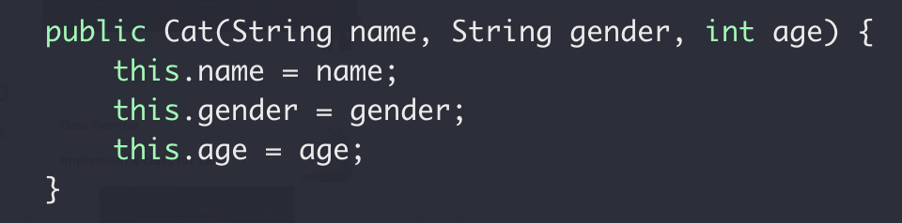
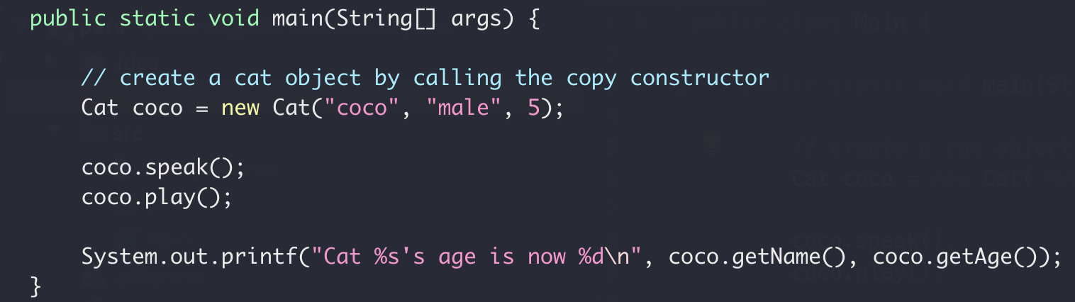
Class Exercise
Copy Constructor

Slide 14
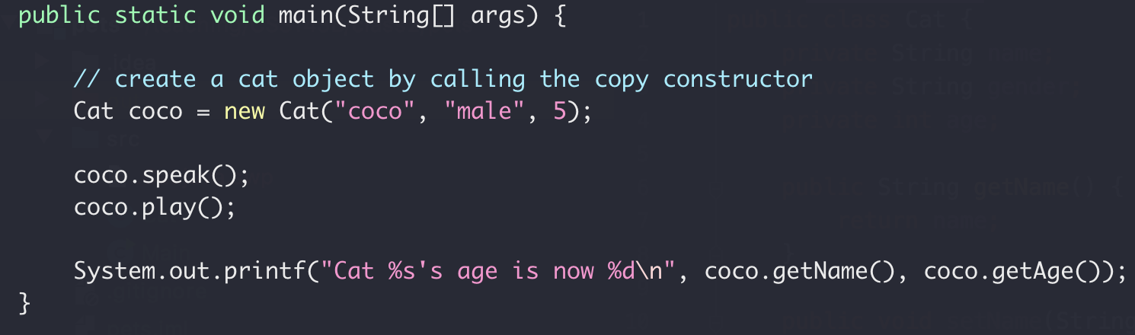
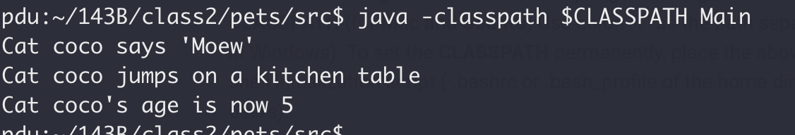
Class Exercise

Slide 15
Encapsulation Summary
Group properties (variables) and methods (that work on properties) into a single concept call “class”
Group properties (variables) and methods (that work on properties) into a single concept call “class”
Member variables should be private (not exposed to outside)
Member variables should be private (not exposed to outside)
What’s the default access level? Public or private?
Constructor to set/initialize members when creating object
Constructor to set/initialize members when creating object
Setter/getter for member properties access

Slide 16
Class Exercise
Implement a class for dogs
Member Variables:
Name
Gender
Age
Member Methods:
Speak
Play

Slide 17
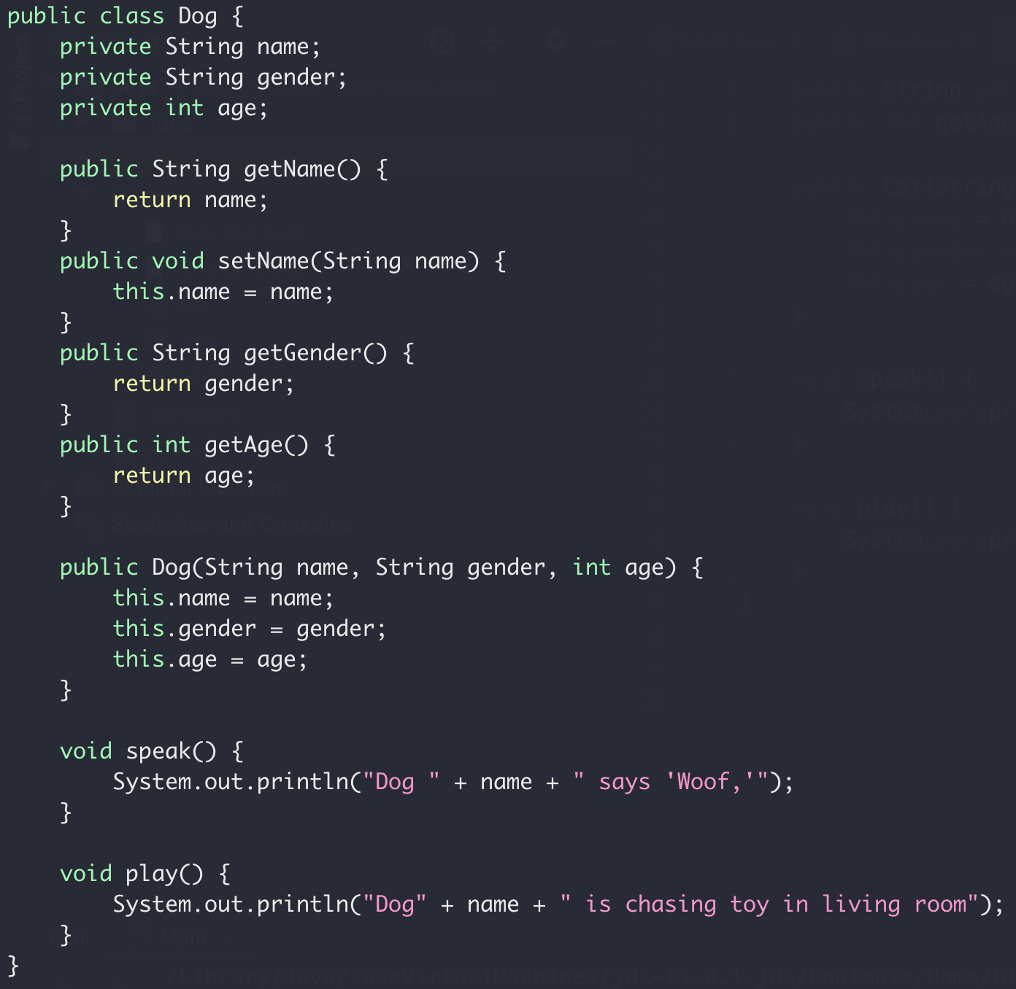
Class Exercise
Implement a class for dogs

Slide 18
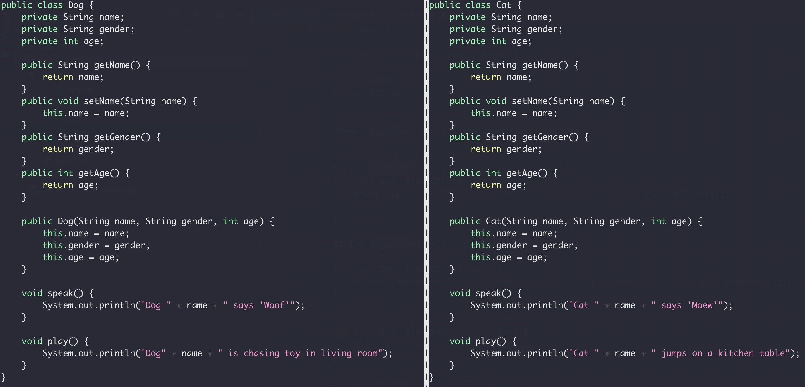
Inheritance
Compare the Cat and Dog class
Duplicated

Slide 19
Inheritance
Animal Class
Name
Gender
Age
Dog Class
Cat Class
Name
Gender
Age
Name
Gender
Age

Slide 20
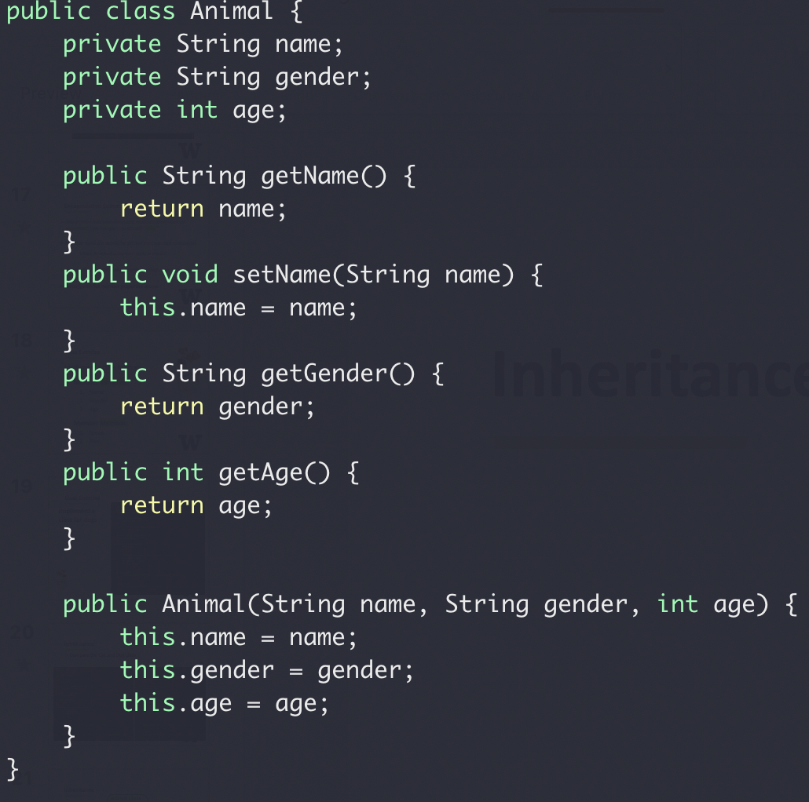
Inheritance
Animal Class
Name
Gender
Age
Base class constructor

Slide 21
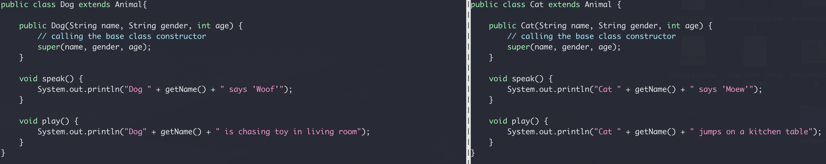
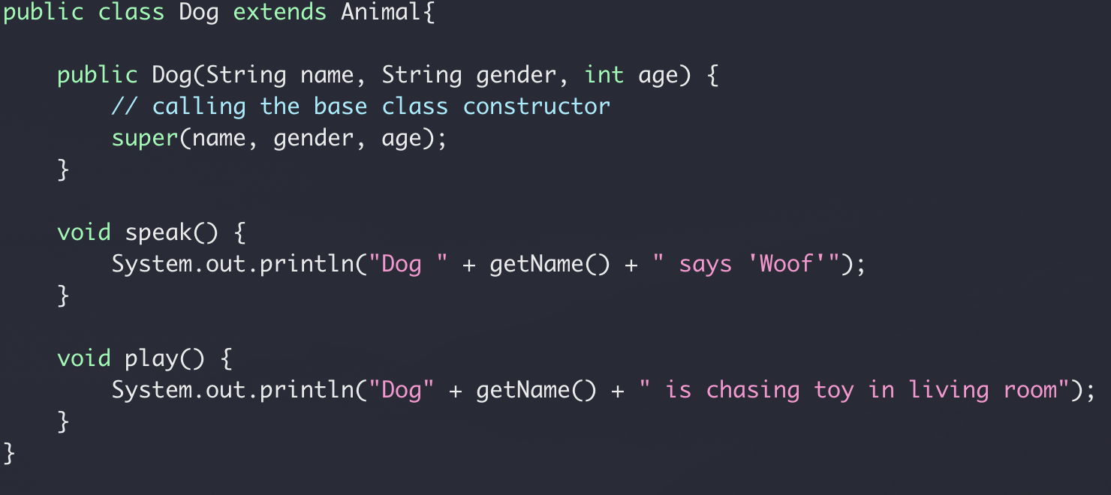
Inheritance
Compare the Cat and Dog class
inheritance
Calling based class constructor

Slide 22
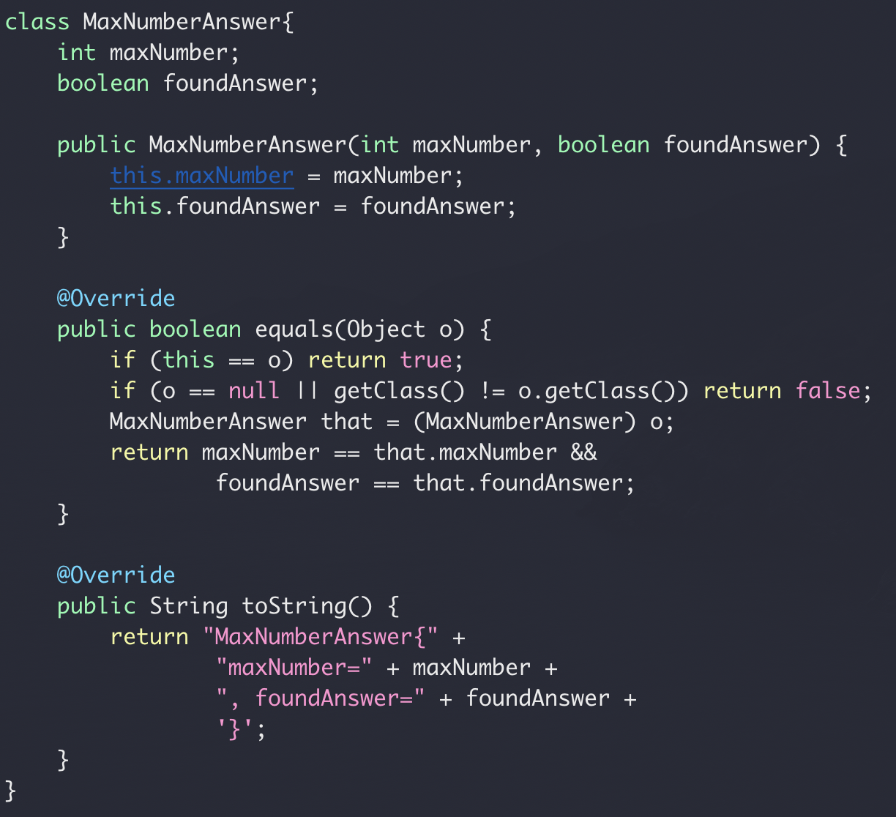
Inheritance
In Java, all classes are derived from the Object class
Yes, your own class too!
Override of the Object class equal() and toString()

Slide 23
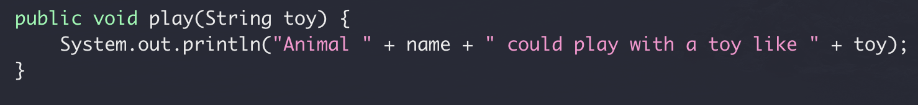
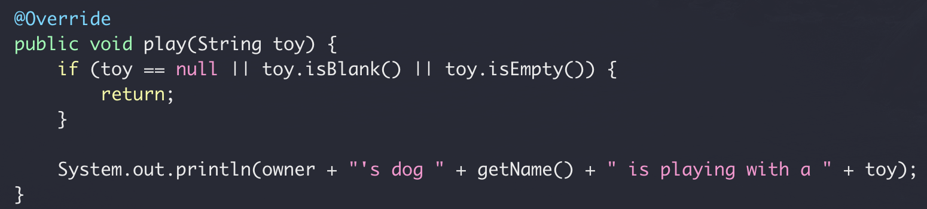
Override vs Overload
Override
Re-implement a function in derived class from base class with the
same name
same signature
Base class: Aniaml.Java
Derived class: Dog.Java

Slide 24
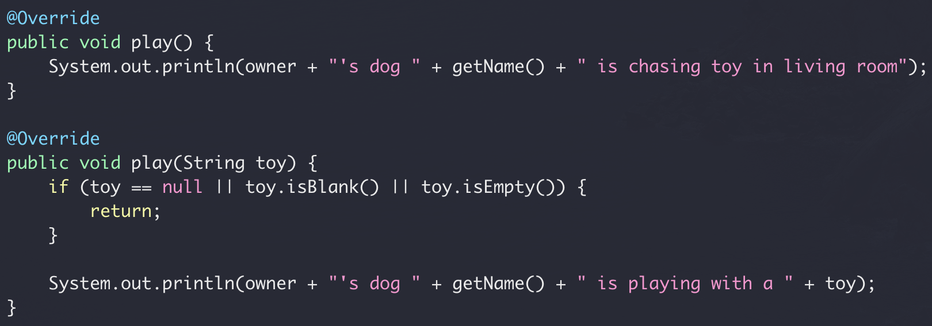
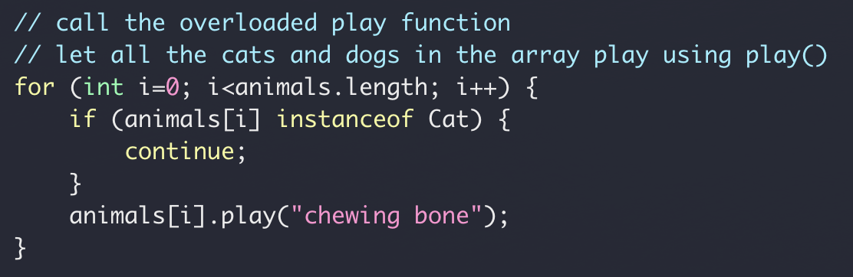
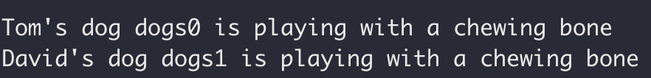
Override vs Overload
Overload
Re-implement a function in the same class
same name
different signature
Derived class: Dog.Java

Slide 25
Inheritance Summary
Base class & derived class
Use super to access the base
Override vs Overload

Slide 26
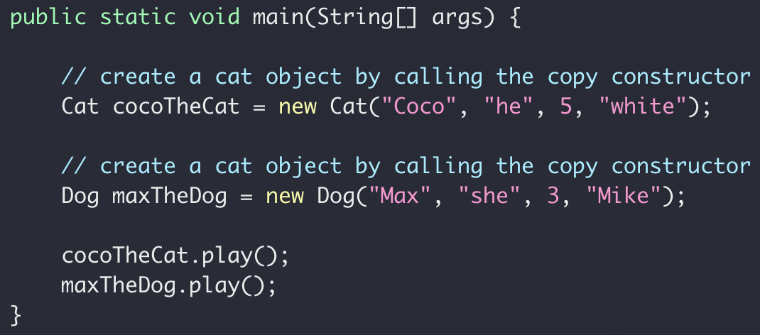
Class Exercise
Let all cats and dogs play
What if we have 300 cats and 200 dogs?
What if we have 3 cats and 2 dogs?

Slide 27
Polymorphism
Animal Class
public void play()
Dog Class
Cat Class
public void play()
public void play()

Slide 28
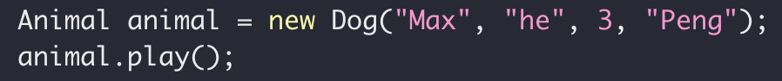
Polymorphism
Dog Instance
Assignment
Animal reference
public void play()

Slide 29
Polymorphism
Cat Class
Assignment
Animal reference
public void play()

Slide 30

Polymorphism
Same reference type (base class), different objects (derived class)
“late binding”

Slide 31
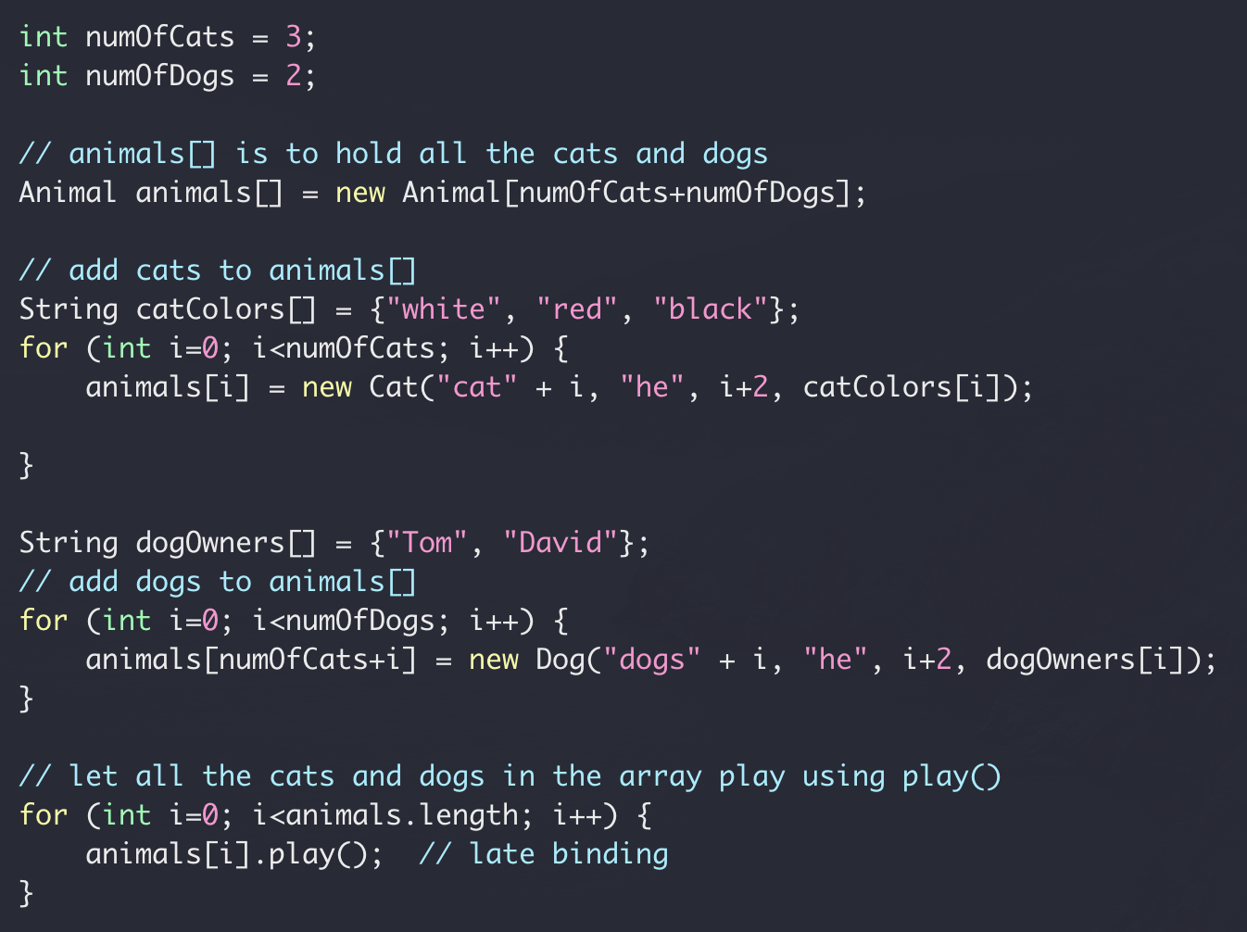
Polymorphism

Slide 32
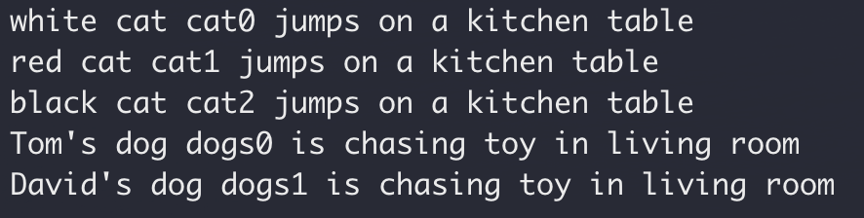
Polymorphism

Slide 33
Polymorphism Summary
Overridden method
Access using base class instance reference
Late binding: actual method being invoked is determined at run time

Slide 34
Abstract Class
Animal Class
public void play()
public void play()
No need to implement
Dog Class
Cat Class
Dog Class
Cat Class
public void play()
public void play()
public void play()
public void play()

Slide 35
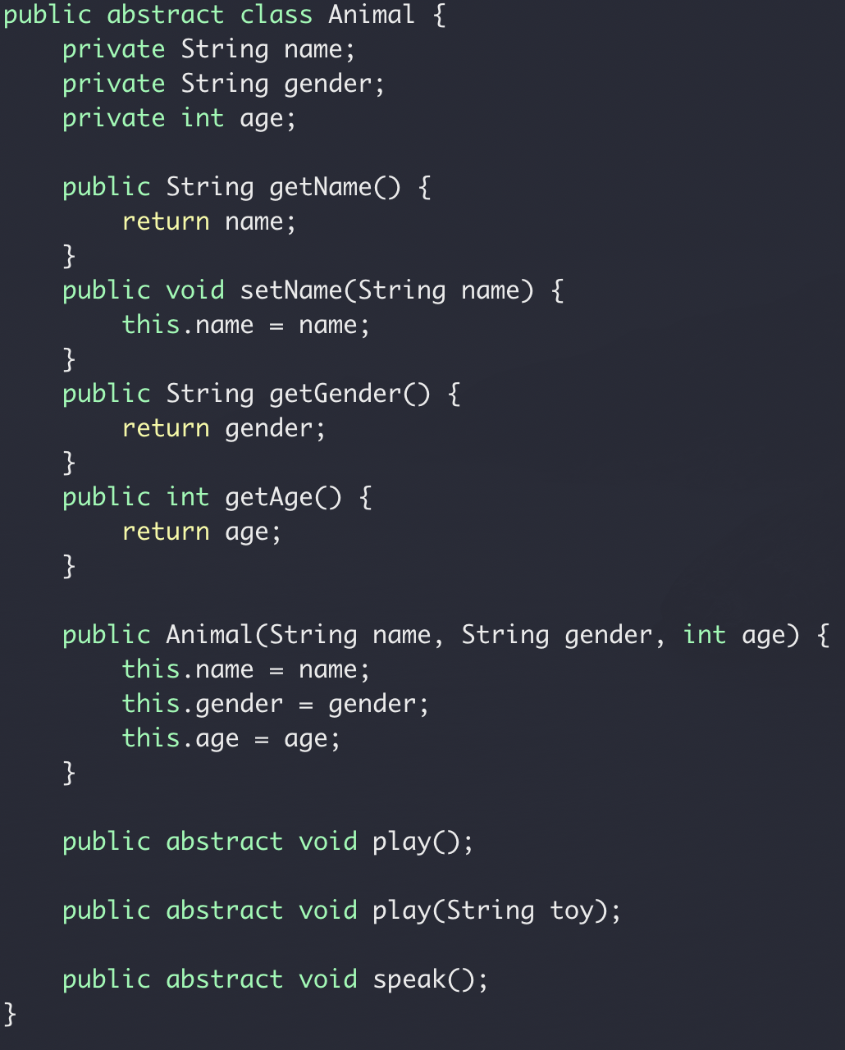
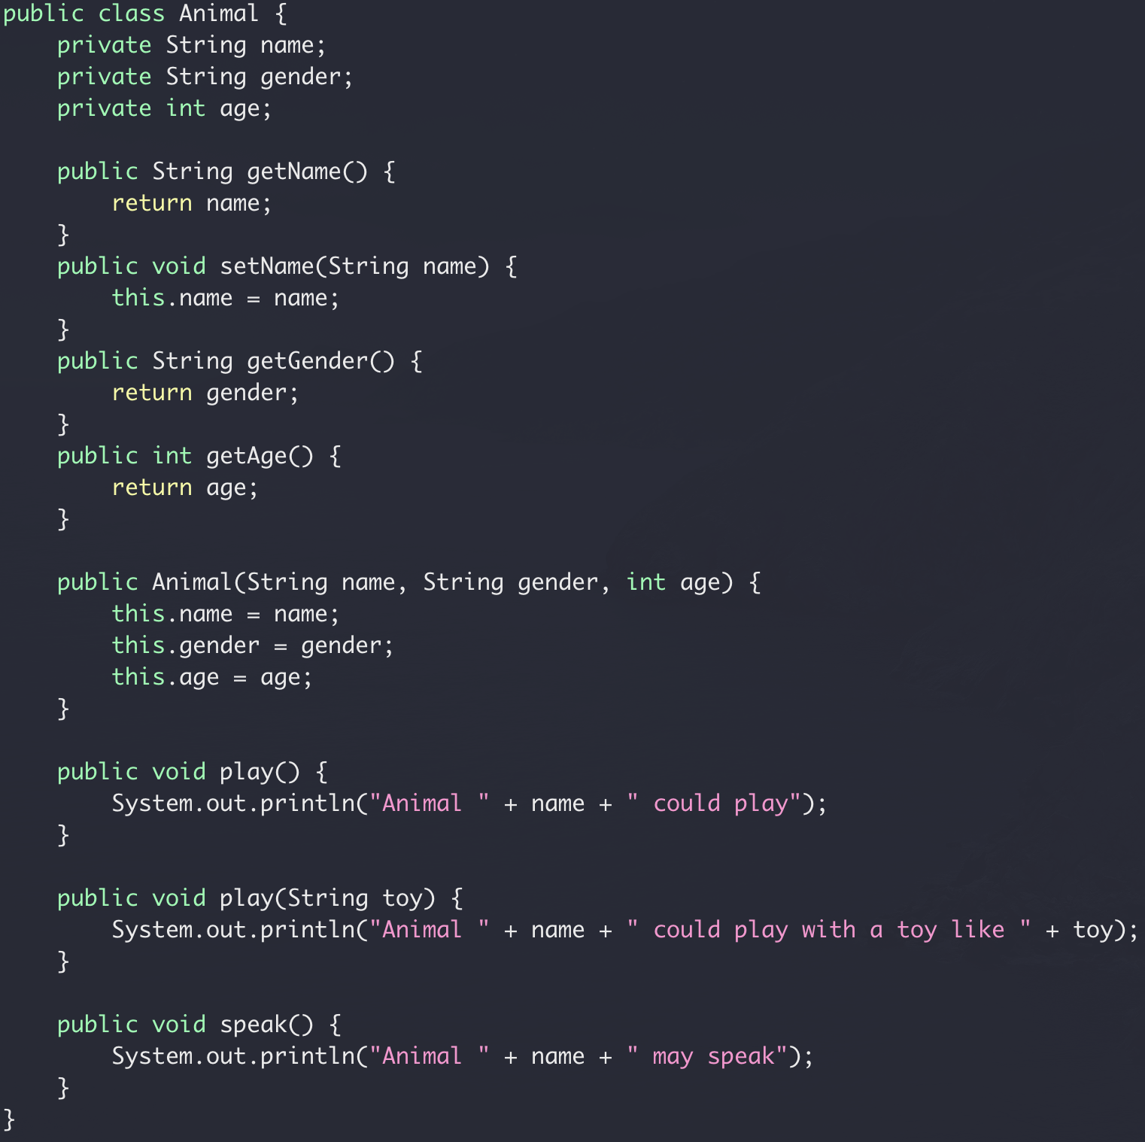
Abstract class

